Slide 1

Substance abuse among anesthesia care providers
University of Wisconsin Clinical Anesthetists’ Competency Series Presentation
Migdiel Hiram Moretta CRNA

Slide 2
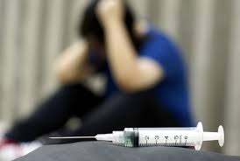
Substance Abuse Among Anesthesia Care Provider
Grossly under estimated
Disclosure is limited and discouraged due to
  Sensitivity of issue
  Legal issues associated with practice
  Implications for patient care

Slide 3
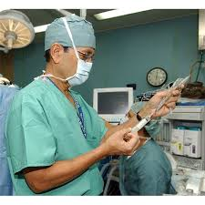
Incidence of Substance Abuse Among Anesthesia Care Providers
Anesthesiologists: 5.5%
      Lutsky (1993)
  Academic anesthesiology programs
    1.6% faculty
    1% residents
        Booth (2002)
Nurse Anesthetists: 10% admit to misusing during their career
  Benzodiazepines, nitrous oxide, potent opiods, and propofol being the most common
      Bell, unpublished data, (2006)
Notes:
Fentanyl was the most commonly abused controlled substance followed by ketamine and thiopental
In 18% of the residents and faculty- death or near death due to an overdose was the initial indicator of abuse

Slide 4

Abuse of anesthetic medications…
Can occur in all groups of anesthesia professionals…
  Physicians in practice
  Residents in training
  Anesthetists
    CRNAs
    AAs
  Student anesthetists

Slide 5
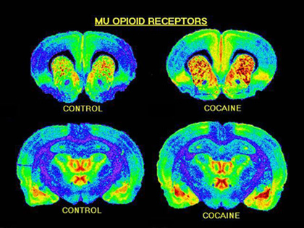
Major factors associated with Chemical Dependency
  Biological
  Neurobiological
    Alterations in the neurotransmission of the reward system
  Genetics
    Susceptibility to addictive behaviors
Notes:
Neurobiological-
Reward system responsible for sense of pleasure and a feeling of wanting whatever it was that brought the sense of pleasure
Neuropathways modulate the importance and the salience (ie wanting) of the substance that resulted in pleasure.
In addiction, both the reward and the salience associated with the substance of abuse is inflated.
Acquisition of the reward becomes top priority, regardless of negative consequences associated with its use.
Genetics-
When exposed to addictive substances, a genetically susceptible person is more likely to develop a pattern for dependency than someone who is not genetically susceptible.
Family history of addiction- strongest predictor for relapse of opiod abuse among anesthesia providers

Slide 6

Major factors associated with Chemical Dependency
Psychological
  Comorbid psychiatric disorders
  Sensation/excitement-seeking personality traits
Notes:
Evidence supports that anesthesia care providers with chemical dependency have comorbid psychiatric disorders.
Sensation-seeking and impulsivity personality traits have been associated with substance abuse and addiction.

Slide 7
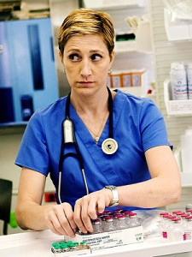

Major factors associated with Chemical Dependency
Occupational
  Medication access
  Pharmacological Knowledge
Notes:
Common to ALL health care professionals, factors influencing the development of substance abuse can be grouped into 3 major occupational hazards:
Stress- substance is perceived as a mechanism for coping with stressful situations and relieving the anxiety associated with the stressor.
Access- unique access to medications, especially controlled substances. Research suggests that increased access increases potential for abuse.
Attitude- pharmacological optimism: because anesthesia providers are comfortable controlling minute-to-minute changes in patient’s vital organs with medications an
attitude of invincibility regarding self medication and feeling of immunity against untoward effects of medications can be developed.
It is hypothesized that second hand exposure to opiods in the OR alters the reward pathway, predisposing anesthesia providers to the development of opiod dependency… interesting…

Slide 8
Major factors associated with Chemical Dependency
Stress
  working as an anesthesia provider is an occupational risk for the development of substance abuse
    Long hours or nights
    Strained working relationships
    Responsibility to patients
    High acuitity of patient conditions
    Increased responsibility without the increased authority or recognition

Slide 9

Typical observed behavior-pattern changes
Withdrawal from family, friend, and leisure activities
  More time spent at work were drug can be used
Mood swings
  Depending on whether addicted provider is high or in withdrawal
Spending more time at hospital, even when off duty
Refusing lunch or coffee breaks
Frequent bathroom breaks requests
  Where addicted provider frequently self administers drugs
Notes:
Periods of depression or bad moods alternated with periods of euphoria or gregariousness.
Increased episodes of anger, irritability and hostility. Increased sensitivity to criticism.
Odd intentions- (coming in on a Saturday afternoon to “set up” a room for a case scheduled for late on Monday) in order to obtain and use drugs
Refusal of breaks lessens chance of discovery of drug diversion activities

Slide 10
Typical observed behavior-pattern changes
Failure to respond to pager, difficult to arouse when on night call
Signing out increasing amounts of narcotics or inappropriate quantities for given case
  So that more is available for self-administration
Frequent “ampoule breakage” and increased “waste”
Weight loss, pale skin
Wearing long sleeves or other clothing to hide physical evidence of self-injection
Notes:
Period of time over which these changes occur depends on drug on which individual is becoming addicted to. Alcohol typically takes years to become evident. Short acting opiod used is apparent in a matter of months.
Depending on the half-life of the abused agent, tolerance can develop rapidly. It is not uncommon for the addict in recovery to report self administer 1,000 mcgs of fentanyl in a single injection, often simply to relieve symptoms of withdrawal.
Often it can be noted a rise of quantity of opiods requested, particularly on Fridays- with upcoming weekend drug unavailability.

Slide 11
Suspected coworker- what to do
Observation
Share concerns with supervisor
Gather information and DOCUMENT
Do NOT confront colleague.

Slide 12

Responsibility of Colleague
Observation
DOCUMENTATION
Reporting observations to supervisor
Support confrontation and advocacy
Support retention/reentry

Slide 13
Responsibility of Supervisor/Facility
Develop FAIR policies in advance of need
Once aware of abuse:
  Gather information
  Thoroughly assess all information and all options
  Maintain CONFIDENTIALITY
  Drug test the suspect but be prepared to test everyone

Slide 14
Intervention:
“do”
PLANNED EVENT
Have a trained interventionist present at all times
Better to have larger group than smaller. Never alone.
  Include individual’s spouse, family member, friends, and colleagues. Include anyone who is close to individual so long as they are supportive of intervention and will not be disruptive
Be sensitive to gender
  Not all males in the intervention team if individual is a female
Bring all evidence of valid documentation of observations and records
Evaluation is not option but a must!
Notes:
Anesthesia groups should have a designated individual responsible for the health and welfare of its members.
This designated person or group needs sufficient information and expertise to assist in intervention.
This is an extremely sensitive position for interventions must be handled with the upmost care to avoid ruining the career of a colleague.

Slide 15
Intervention:
“don’t”
Do not let person leave intervention by themselves
Do not let them drive
Do not fail to make arrangement for direct transfer to an inpatient facility prior to intervention
Do not let the individual decide their treatment
Notes:
Impaired individual may become suicidal once gravity of situation is realized and they may also have a “stash” in their car or locker
An intervention will either build the wall of denial higher or break it down, which is why it is critical to do it right.
Only as last resort, when all else fails, you should threaten to call the police

Slide 16
Legal issues
Diversion of controlled substances is illegal.
Failure to report an impaired anesthesia provider when patient harm has occurred as required by law may result in disciplinary action against the institution or designated individual.
The American with Disabilities Act offers some protection to addicted providers. No protection, however is afforded to users of illegal drugs (other substances other than alcohol).
Notes:
ADA protects the individual whether in treatment or not if the substance is alcohol.
If substance other than alcohol, protection is afforded only when person in not actively using and is in treatment.

Slide 17
Diversion/Impaired Professional Programs
States’ Medical/Nursing board may suspend or revoke an individual’s license
Additionally, federal, state, and local authorities may institute criminal action for diversion of controlled substances
In certain circumstances, alternative to suspension or revocation:
  enrollment in “voluntary” diversion* programs designed to rehabilitate the affected professional and return him or her to their practice
Notes:
Individual circumstances determine if ultimately license will be lost
* Diversion in this instance is defined as the process of intervening in the case of a physician or a nurse and arranging for assessment, treatment, and potentially return to practice independent of licensure authorities

Slide 18
Alternative to discipline
Professional Assistance Procedure (PAP) http://dsps.wi.gov/Other-Services
PAP is a CONFIDENTIAL program for chemically impaired professionals.
For the majority of chemically dependent professionals, there is now an opportunity to seek treatment without losing their professional credentials.
PAP promotes early identification of chemically dependent professionals and encourages their rehabilitation.
PAP offers participants an opportunity to obtain treatment for chemical dependency while ensuring that immediate action can be taken should a participant relapse or drop out of treatment. Participation in PAP will not exempt the professional from discipline.
PAP does not provide treatment, but monitors participants’ progress in treatment with an approved treatment provider.
If you or someone you know is a credentialed professional and is having problems with alcohol or other drugs, the Professional Assistance Procedure (PAP) may be the answer. Timely and effective treatment can save the professionals career and even their life.
Notes:
The professional assistance procedure is a non-disciplinary monitoring program that may be offered to credential holders when alcohol and/or drug abuse allegations have been made.
Compliance with PAP’s compliance agreement allows you to retain your professional credential, and action will not be pursued.
Participation is voluntary. The alternative is for the Board to take further action against your credentials

Slide 19
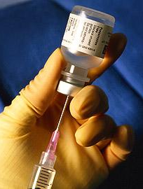
Addiction
Being an anesthesia provider seems to be an independent risk for dying of drug-related causes.
Death is a very real possibility!

Slide 20
Consider…
Your spouse & your children and their emotional & financial wellbeing
Your colleagues are interested in YOUR wellbeing
Chemical dependency is not about moral failure or lack of will power or lack of intelligence
Addiction is an illness

Slide 21
Where to go for help…
AANA Health and wellness and peer assistance
  http://www.aana.com/resources2/peer-assistance/pages/default.aspx
AANA hotline 800-654-5167 open 24/7
www.aa.org
www.na.org
WI Professional Assistance Procedures
  http://dsps.wi.gov/Other-Services

